Slide 1
CS 4700:
Foundations of Artificial Intelligence
Carla P. Gomes / Bart Selman
gomes@cs.cornell.edu
Module:
Perceptron Learning
R&N 18.7

Slide 2
Derivation of a learning rule for Perceptrons Minimizing Squared Errors
Threshold perceptrons have some advantages , in particular
→ Simple learning algorithm that fits a threshold perceptron to any
linearly separable training set.
Key idea: Learn by adjusting weights to reduce error on training set.
→ update weights repeatedly (epochs) for each example.
We’ll use:
→Sum of squared errors (e.g., used in linear regression), classical error measure
→Learning is an optimization search problem in weight space.

Slide 3
Derivation of a learning rule for Perceptrons Minimizing Squared Errors
Let S = {(x_{i}, y_{i}): i = 1, 2, ..., m} be a training set. (Note, x is a vector of inputs, and y is the vector of the true outputs.)
Let h_{w} be the perceptron classifier represented by the weight vector w.
Definition:

Slide 4

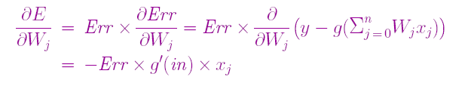
Derivation of a learning rule for Perceptrons Minimizing Squared Errors
The squared error for a single training example with input x and true output y is:
Where h_{w} (x) is the output of the perceptron on the example and y is the true output value.
We can use the gradient descent to reduce the squared error by calculating the partial derivatives of E with respect to each weight.
Note: g’(in) derivative of the activation function. For sigmoid g’=g(1-g). For threshold perceptrons,
where g’(n) is undefined, the original perceptron rule simply omitted it.

Slide 5



Gradient descent algorithm → we want to reduce , E, for each weight w_{i} , change weight in direction of steepest descent:
Intuitively:
Err = y – h_{W}(x) positive
output is too small → weights are increased for positive inputs and decreased for negative inputs.
Err = y – h_{W}(x) negative
→ opposite
α learning rate
W_{j} ← W_{j} + α × I_{j} × Err

Slide 6
Perceptron Learning:
Intuition
Rule is intuitively correct!
Greedy Search:
Gradient descent through weight space!
Surprising proof of convergence:
Weight space has no local minima!
With enough examples, it will find the target function!
(provide α not too large)

Slide 7
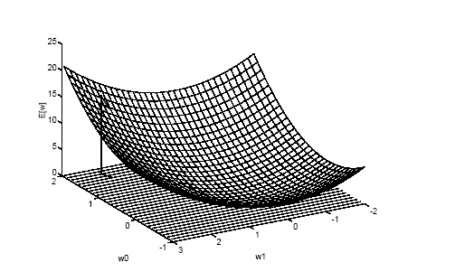
Gradient descent in weight space
From T. M. Mitchell, Machine Learning

Slide 8
W_{j} ← W_{j} + α × I_{j} × Err
Perceptron learning rule:
  Start with random weights, w = (w₁, w₂, ... , w_{n}).
  Select a training example (x,y) ∈ S.
  Run the perceptron with input x and weights w to obtain g
  Let α be the training rate (a user-set parameter).
  Go to 2.
Epoch → cycle through the examples
Epochs are repeated until some stopping criterion is reached—
typically, that the weight changes have become very small.
The stochastic gradient method selects examples randomly from the training set rather than cycling through them.

Slide 9
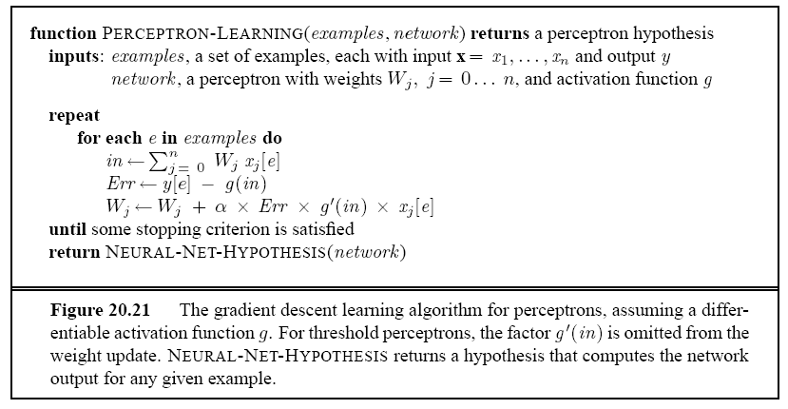
Perceptron Learning:
Gradient Descent Learning Algorithm

